Slide 1
Bottom-Up feature extraction
Top-Down prediction
1/32 (W x H) x 2048
256
1/16 (W x H) x 1024
ResNet101.layer4
256
1/8 (W x H) x 512
ResNet101.layer3
256
Conv1
3x3
Conv2
3x3
1/4 (W x H) x 256
ResNet101.layer2
256
64
ResNet101.layer1
1/4 (W x H) x 1
(Greyscale Image)
Input RGB Image
W x H x 3
2x Upsample
3x3 conv

Slide 2
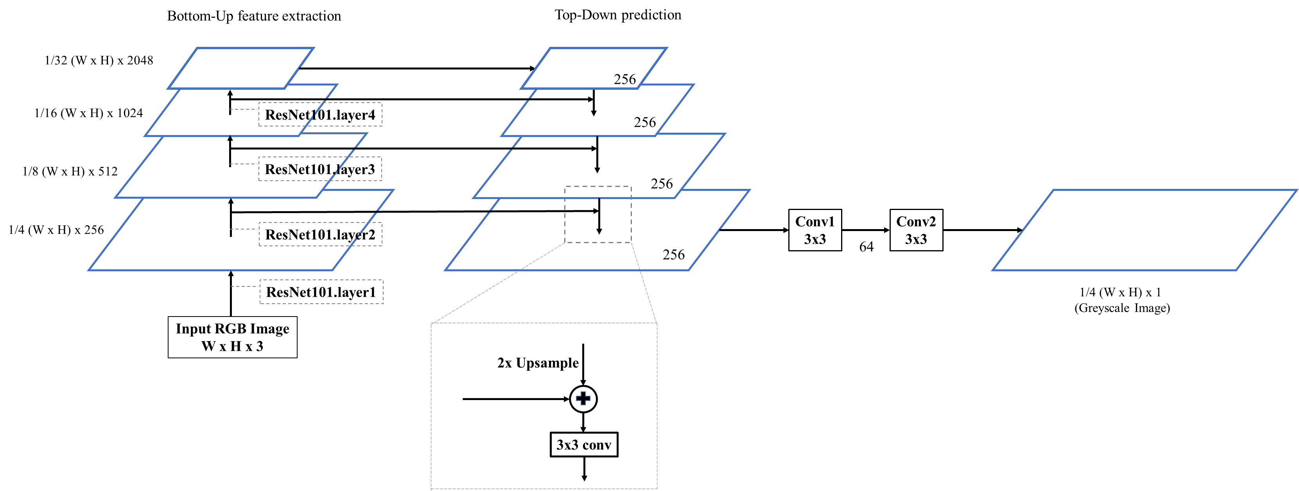
Our Architecture

Slide 3


Fork me on GitHub!
https://github.com/wolverinn/Depth-Estimation-PyTorch

